Slide 1


QST STARBUCKS
TEAM: Sinyoung Jeong, Rajyashree Ramaprabu, Diego Alejandro Leonardo Garcia, Kris Pandeli

Slide 2
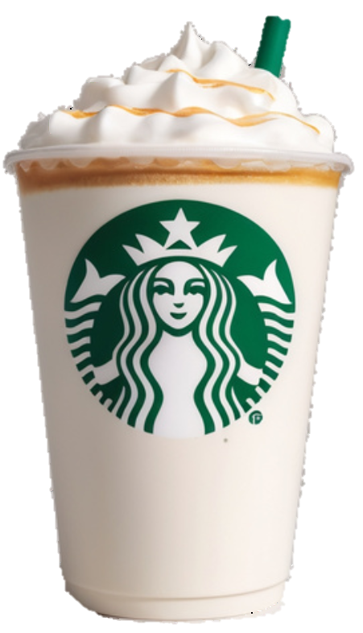

TABLE OF CONTENTS
Improve Phase
Define Phase
01
04
Recommendations for Process Improvement, Improved
Process Map, Projected DPMO,
Risk Response Matrix
Voice of the Customer,
Project Charter
Measure Phase
Control Phase
02
05
Statistical Process Control
Charts, DPMO
Recommended Approach to
Control + Sustain the Improved
Process
Analyze Phase
CONCLUSION
Current Process Map, Design &
Analysis of Experiments, Process Waste Identification & Analysis, Ishikawa Diagram
03
06
Q & A

Slide 3
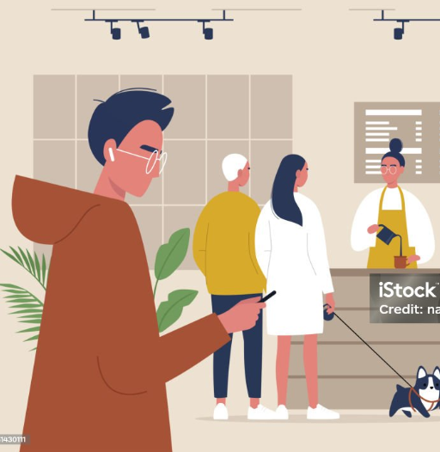
DEFINE
MEASURE
ANALYZE
IMPROVE
CONTROL
VOICE OF THE CUSTOMER
“I have to wait too long in the queue, which is frustrating when I’m in a hurry.” - Customer 1
“The checkout process is too slow, and I often consider going to a different coffee shop.” - Customer 2
“I sometimes spend more time waiting to pay than actually enjoying my coffee.” - Customer 3

Slide 4
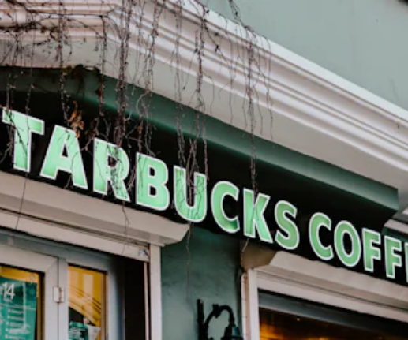
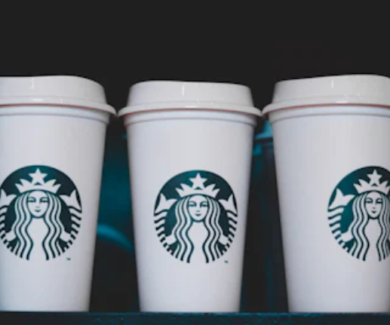
DEFINE
MEASURE
ANALYZE
IMPROVE
CONTROL
1
PROCESS CONTEXT
2
THE PROBLEM
In the coffee shop industry, customer satisfaction and quick service are crucial for retaining customers and driving revenue.
QST-Starbucks currently lacks self-checkout options, leading to longer wait times and potential customer attrition.
3
WHY IS THIS A PROBLEM
Negative shopping experiences
Decreased customer retention
Harming QST-Starbucks' reputation and revenue

Slide 5
DEFINE
MEASURE
ANALYZE
IMPROVE
CONTROL
PROJECT CHARTER
Business Case
Process Goal
Enhance Shopping Experience
Optimize Operational Efficiency
To reduce the average customer waiting time at checkout in QST-Starbucks.
Metrics
Benefits
Customer waiting time
Current waiting time: 10 minutes
Goal: < 5 minutes
Enhance Customer Satisfaction
Increase Revenue
Improve Reputation

Slide 6
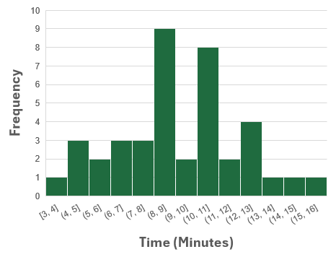
DEFINE
MEASURE
ANALYZE
IMPROVE
CONTROL
Waiting time at QST Starbucks without improvements
Number of Samples | 40
Process Mean | 9.28 mins
Process Standard Deviation | 2.79 mins
Z-Test
Null hypothesis | H₀: μ =< 5
Alternative hypothesis | H₁: μ > 5
Z-Value | P-Value
9.71 | 0.0000
Since the p-value (0.000) is smaller than 95% level of significance (0.05), reject the H₀. Thus, the population mean waiting time is GREATER than 5 minutes.

Slide 7
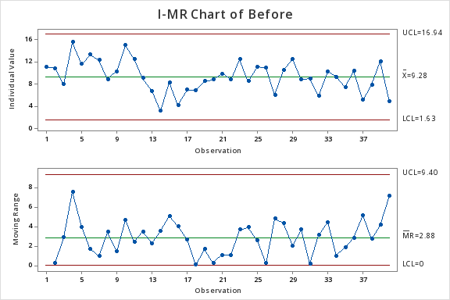
DEFINE
MEASURE
ANALYZE
IMPROVE
CONTROL
Statistical Process Control Chart
Data: Waiting time at QST Starbucks without improvement Variable Data: Waiting time / Sample size = 1

Slide 8
DEFINE
MEASURE
ANALYZE
IMPROVE
CONTROL
DPMO (Defects Per Million Opportunities) / Process Capability
- WITHOUT improvement
5 min
Number of Samples | 40
Target Mean | 5 mins
Process Mean | 9.28 mins
Process Standard Deviation | 2.79 mins
Proportion of Defectives | 0.94
DPMO (> 5min defectives) | 937,661.53
Waiting Time (min)
The Sigma Level of this Process is LESS than 1.

Slide 9
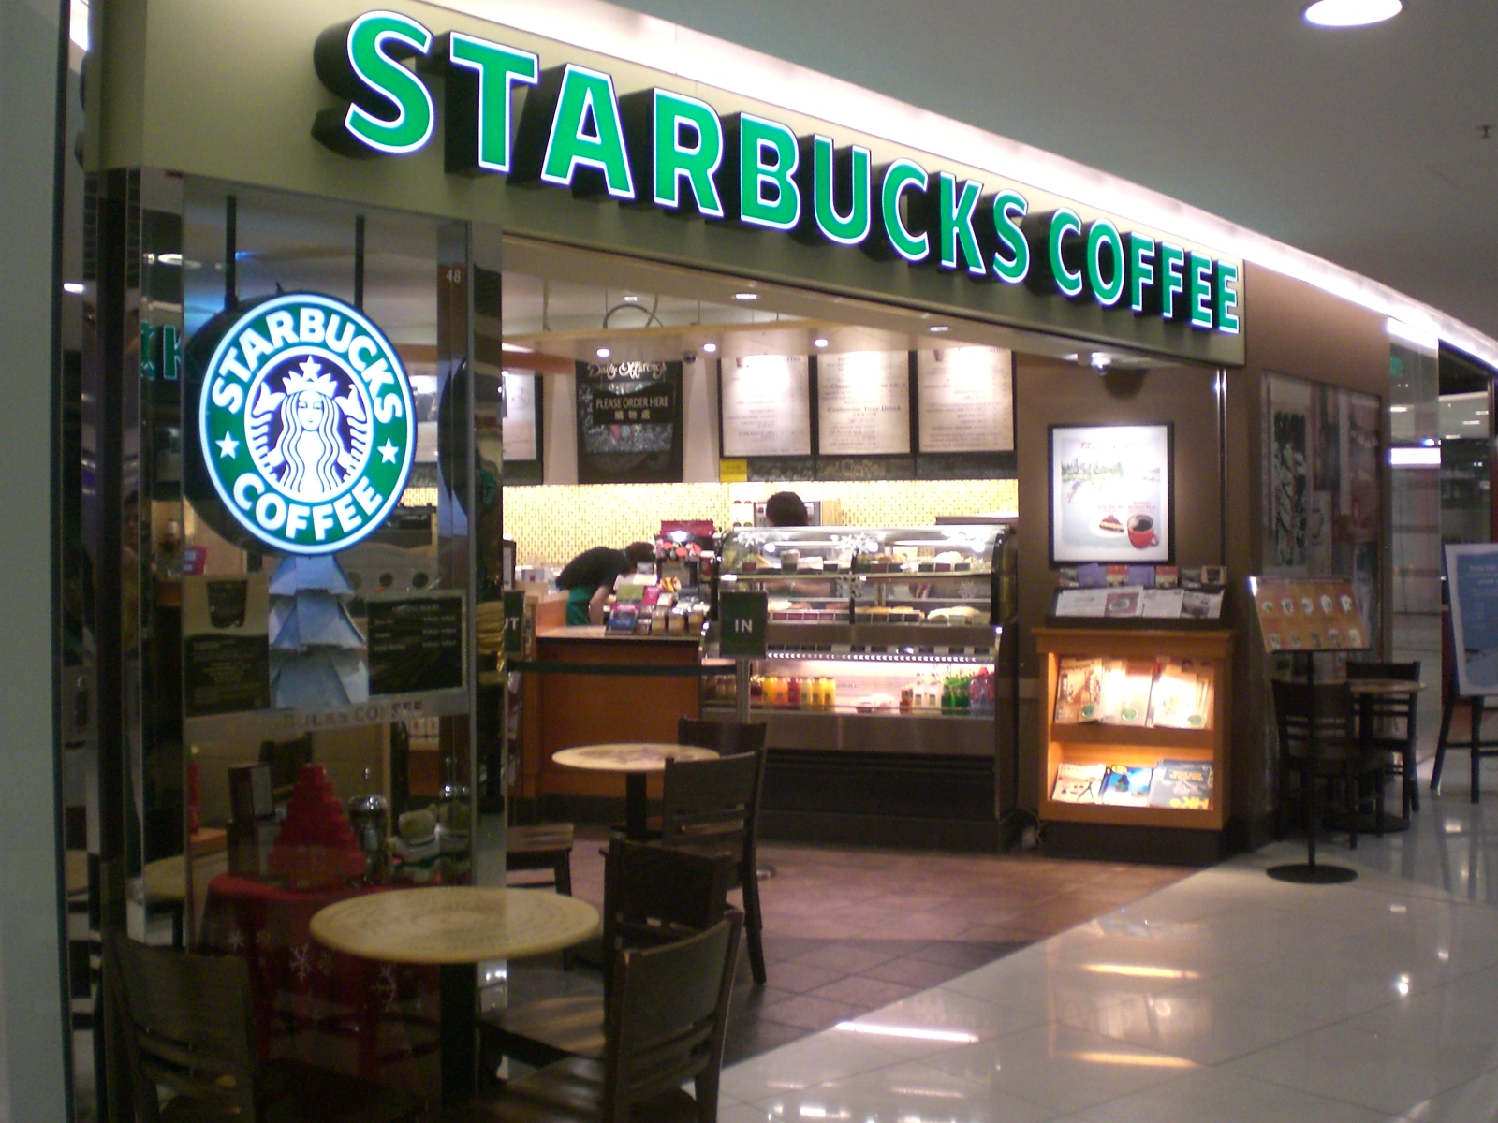
DEFINE
MEASURE
ANALYZE
IMPROVE
CONTROL
Current Process Map - Placing an Order
Customer Enters Store
Customer Joins Queue
Barista Greets Customer
Customer Places Order
Barista Inputs Order into POS System
Barista Confirms Order and Price
Customer Pays for Order
Barista Processes
Barista Prints Receipt (if requested)
Barista Hands Over Order Number/Name
Customer Waits for Order
Card/Mobile Payment
Cash Payment
ThePhoto by PhotoAuthor is licensed under CCYYSA.

Slide 10
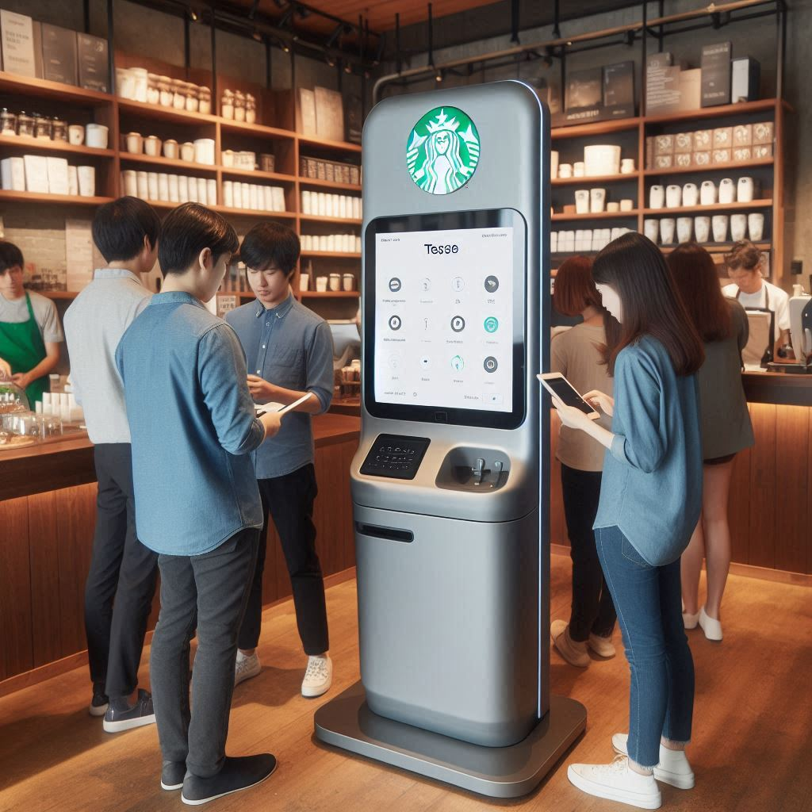


DEFINE
MEASURE
ANALYZE
IMPROVE
CONTROL
Design and Analysis of Experiments
Time
Self Checkout Kios
Summer Promotion Drinks
Morning
Afternoon
Image created by DALL-E

Slide 11
DEFINE
MEASURE
ANALYZE
IMPROVE
CONTROL
Design and Analysis of Experiments
2³ DOE with two replicates (16 Runs)
Factors | Option 1 | Option2
Time | Morning | Afternoon
Self Checkout | No | Yes
Summer Promotion | No | Yes
Goal: Minimize Waiting Time
 |  |  | Waiting Time (min)
Time | Self-Checkout | Promotion | Replicate 1 | Replicate 2
Morning | No | No | 10.5 | 9.8
Afternoon | No | No | 9.5 | 10
Morning | Yes | No | 5.5 | 4.8
Afternoon | Yes | No | 4.5 | 4.5
Morning | No | Yes | 14 | 14.5
Afternoon | No | Yes | 14.8 | 13.8
Morning | Yes | Yes | 6.5 | 5.8
Afternoon | Yes | Yes | 7 | 6

Slide 12
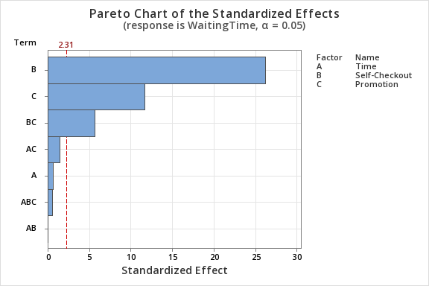
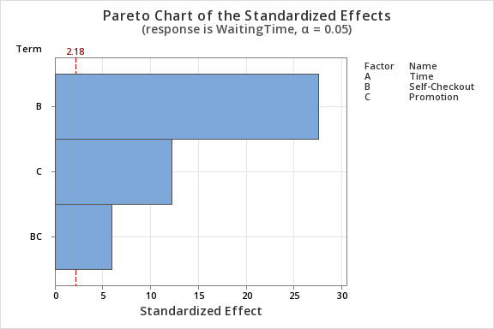
DEFINE
MEASURE
ANALYZE
IMPROVE
CONTROL
Design and Analysis of Experiments
2³ DOE with two replicates (16 Runs)
Factors | Option 1 | Option2
Time | Morning | Afternoon
Self Checkout | No | Yes
Summer Promotion | No | Yes
Goal: Minimize Waiting Time

Slide 13
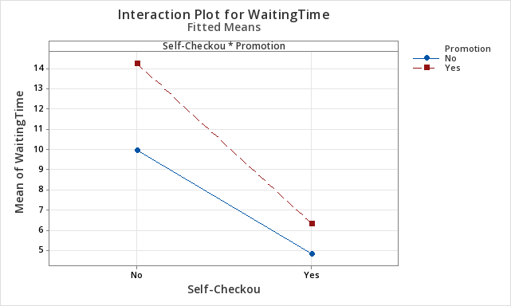
DEFINE
MEASURE
ANALYZE
IMPROVE
CONTROL
Design and Analysis of Experiments
Recommendations to MINIMIZE waiting time at QST Starbucks:
Without the summer promotion, the Self Checkout Kiosk should BE implemented.
During the Summer promotion, the Self Checkout Kiosk should BE implemented.
Self Checkout

Slide 14
Barista moves between POS and prep area
Barista Confirms Order and Price
Over-processing: Repeating order for confirmation
Customer Pays for Order
Waiting: Processing payment during peak times
Barista Processes Payment
Motion: Handling different payment methods
Barista Prints Receipt:
Over-processing: Printing receipts if not needed
Barista Inputs Order into POS
DEFINE
MEASURE
ANALYZE
IMPROVE
CONTROL
Process Waste Identification

Slide 15

DEFINE
MEASURE
ANALYZE
IMPROVE
CONTROL
Ishikawa Diagram
People
Process
Machines
Baristas: Lack of motivation & training
Manual Orders
POS Systems: malfunctions
& no self checkout
Customers: Indecisive
groups ordering at once
Slow payment processing
Order Fulfillment: Bottlenecks in drink prep
Coffee Machines: Insufficient # of machines for peak times
Long
Checkout
Time
Running out of key ingredients
Inefficient layout causing congestion
Inadequate staffing during peak hours
Limited space for queues
Delays in restocking
Lack of streamlined processes
Noise levels affecting communication
Materials
Environment
Management

Slide 16
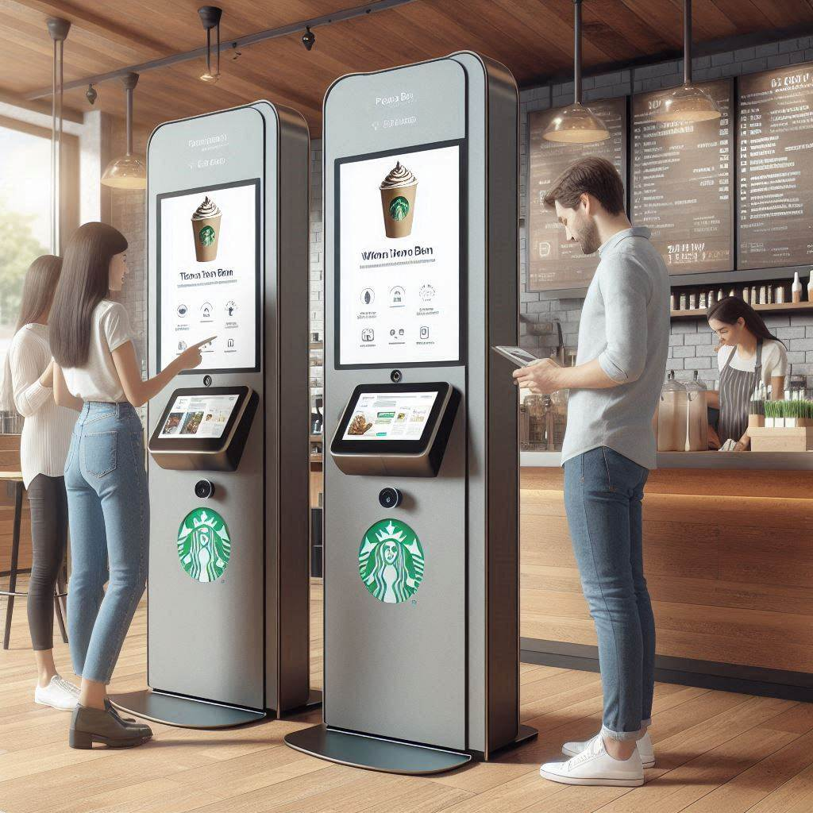
DEFINE
MEASURE
ANALYZE
IMPROVE
CONTROL
Process Improvement Recommendations
Reduce Waiting Time:
Implement Self-Check-out Kiosks, Optimize staff scheduling
Eliminate Over-processing:
Simplify order confirmation and receipt printing
Reduce Defects:
Provide comprehensive training, implement double-check system
Optimize Talent Utilization:
Cross-train baristas, use part-time staff for peaks

Slide 17
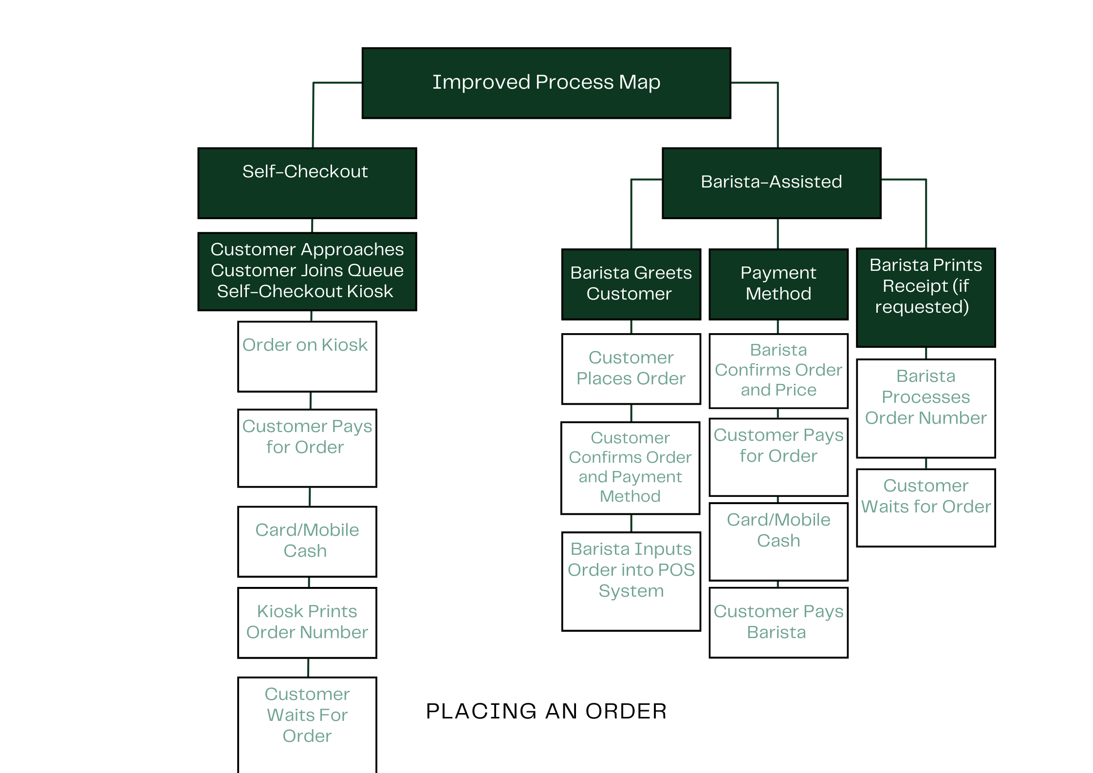
DEFINE
MEASURE
ANALYZE
IMPROVE
CONTROL

Slide 18
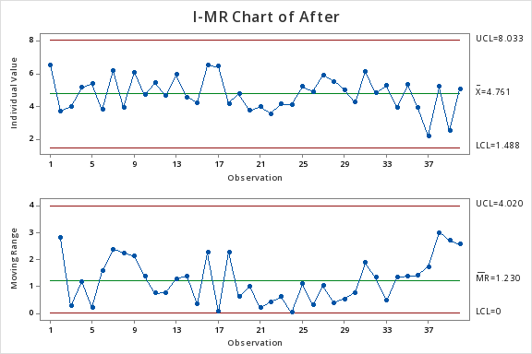
DEFINE
MEASURE
ANALYZE
IMPROVE
CONTROL
Statistical Process Control Chart
Data: Waiting time at QST Starbucks WITH Self Checkout Kiosks Variable Data: Waiting time / Sample size = 1

Slide 19
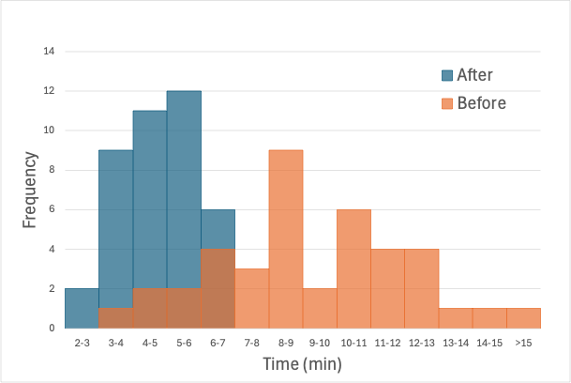
DEFINE
MEASURE
ANALYZE
IMPROVE
CONTROL
Waiting time at QST Starbucks with Self Checkout Kiosks
Number of Samples | 40
Project Mean | 4.78 mins
Project Standard Deviation | 1.03 mins
Z-Test
Null hypothesis | H₀: μ <= 5
Alternative hypothesis | H₁: μ > 5
Z-Value | P-Value
-1.47 | 0.929
Since the p-value (0.929) is greater than the 95% level of significance (0.05), do NOT reject the H₀.
Thus, the population mean waiting time is LESS than 5 mins.

Slide 20
DEFINE
MEASURE
ANALYZE
IMPROVE
CONTROL
DPMO (Defects Per Million Opportunities) / Process Capability
- WITH Self Checkout Kiosks
5 min
Number of Samples | 40
Target Mean | 5 mins
Process Mean with Self Checkout | 4.76 mins
Process Standard Deviation with Self Checkout | 1.03 mins
Proportion of Defectives | 0.41
DPMO (> 5 min defectives) | 407,983.30
Waiting Time (min)
The Sigma Level of this Process with Self Checkout increased between 1 and 2.

Slide 21
DEFINE
MEASURE
ANALYZE
IMPROVE
CONTROL
Risk Response Matrix
Risk | Risk Event | Risk Response
1. Technical Risks | System failures or bugs | Regular software updates, rigorous testing before deployment
 | Integration issues with existing systems (e.g., POS, inventory management) | Conduct thorough compatibility testing and have backup systems in place.
2. Operational Risks | User interface difficulties leading to customer frustration | Design user-friendly interfaces, provide clear instructions, and assistance from staff
 | Increased queue times during peak hours | Optimize kiosk placement, monitor usage patterns, and adjust staffing levels as needed.
3. Financial Risks | High initial investment costs | Perform cost-benefit analysis and pilot the kiosk in select locations before full rollout.
 | Potential for reduced in-store sales due to customer dissatisfaction | Continuously gather feedback and make necessary adjustments promptly.
4. Customer Risks | Customers preferring traditional checkout methods | Maintain traditional checkout options alongside kiosks, offer incentives for using the kiosk, and educate customers on benefits.
 | Negative customer feedback | Set up a feedback mechanism, respond to concerns, and involve customers in the improvement process.
5. Employee Risks | Employee resistance to change | Provide training, communicate benefits, and involve employees in the transition process.
 | Misuse or mishandling of the kiosks by staff | Establish clear usage guidelines, provide comprehensive training, and monitoring mechanisms.

Slide 22
DEFINE
MEASURE
ANALYZE
IMPROVE
CONTROL
Recommended Approach to Control and Sustain the Improved Process
Standard Operating Procedures (SOPs):
Develop and document SOPs for all steps in the order process.
Regularly update SOPs based on feedback and performance data.
Training and Development:
Implement ongoing training programs for baristas.
Focus on cross-training to handle peak times and various roles.
Performance Monitoring:
Use key performance indicators (KPIs) to track efficiency.
Monitor wait times, order accuracy, and customer satisfaction.
Feedback Loop:
Establish a system for customer and employee feedback.
Regularly review and act on feedback to make continuous improvements.
Technology Integration:
Utilize digital tools for real-time order tracking and management.
Implement mobile app updates for seamless ordering and payments.

Slide 23
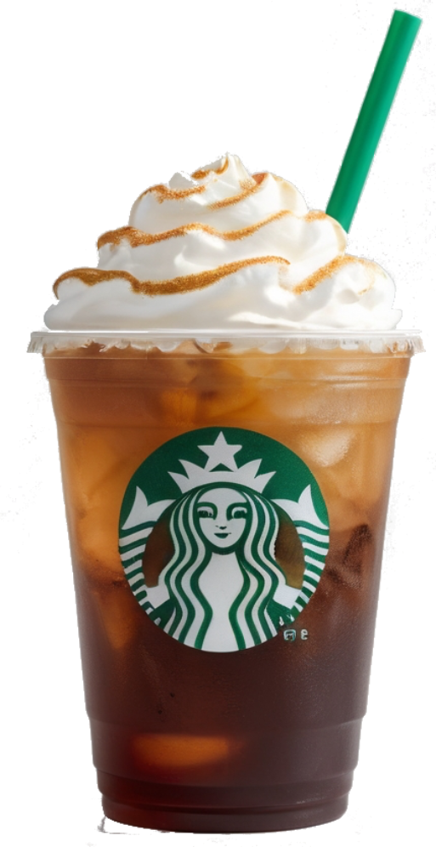
THANK YOU!
QUESTIONS?

